Slide 1
Classification Models
Lesson 20.2

Slide 2
Notes:
### 1. Instructor Do: Welcome Class (5 minutes)

Slide 3
Class Objectives
By the end of the class, you will be able to:
Deploy various machine learning models for classification, such as support vector machines (SVM), k-nearest neighbors, and random forests.
Identify when categorical variables are useful for a machine learning algorithm.
Perform feature engineering on categorical features and convert labels to numerical class representations.
Recognize the type of business cases where decision trees and random forests are a suitable solution for classification problems.
Demonstrate how random forests avoid overfitting and perform better than decision trees.
Identify the pros and cons of tree-based algorithms.
Understand the implications of overfitting and how boosting and bagging can help to deal with it.
Apply Gradient Tree Boosting models in classification problems.

Slide 4

Trees and Ensemble Learning
Today you will learn about several new machine learning models:
Support vector machines (SVM)
k-nearest neighbors
Random forests

Slide 5

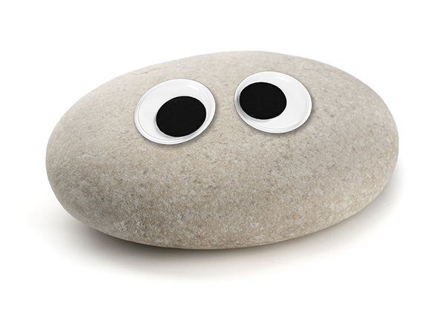
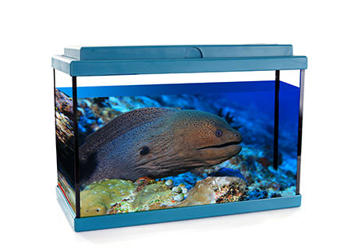

Trees and Ensemble Learning
You will also be introduced to a new family of machine learning algorithms: tree-based algorithms.
Pet Picker: Do you travel?
YES
NO
Are you gone more than one week per month?
Do you like to dress up your pets?
YES
NO
YES
NO

Slide 6
Tree-based algorithms are supervised learning methods that programmers and analysts use primarily for classifications and regression problems.

Slide 7
Trees and Ensemble Learning
This class will cover the following algorithms and methods:
Decision trees
Random forests
Weak learners
Ensemble methods

Slide 9
Support Vector Machines
Notes:
### 2. Instructor Do: Support Vector Machines (10 minutes)

Slide 10

Support Vector Machines
sklearn follows a common pattern of model-fit-predict, which allows machine learning engineers to train, test, and evaluate a variety of machine learning models.
To illustrate this, we will look at a new model called a support vector machine, or SVM.
Notes:
shutterstock_1850471104_robot

Slide 11
Support Vector Machines (SVM) is a supervised learning model that we can use for classification and regression analysis. SVM separates classes of data points into multidimensional space.

Slide 12

Support vector machines are a widely applied model in Data Science, especially for assessing credit risk and fraud detection.
Notes:
shutterstock_1954985212

Slide 13
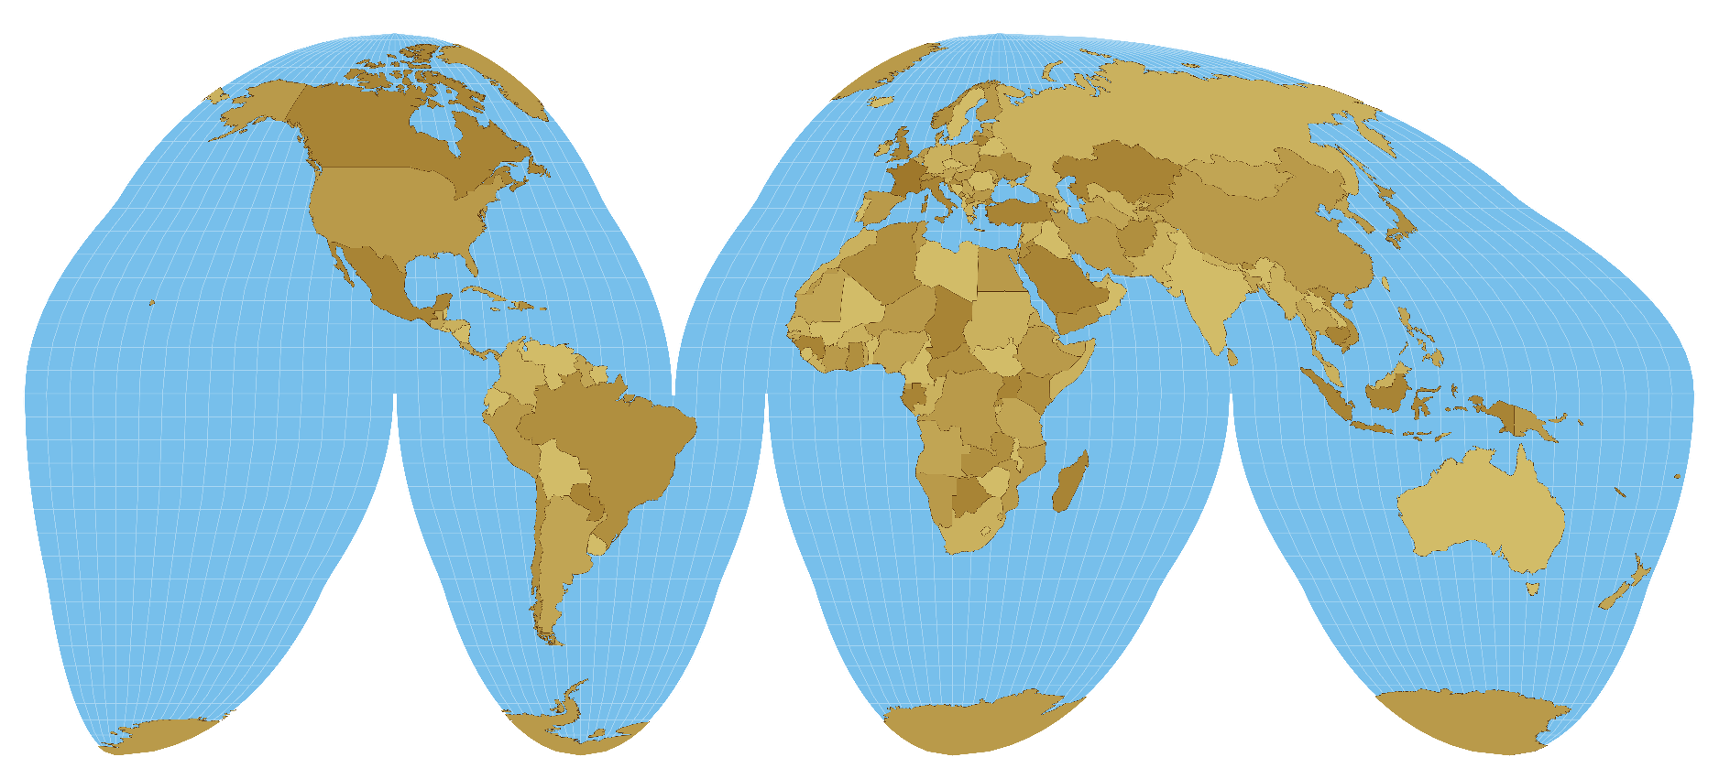
Support Vector Machines
The idea behind SVMs is that a dataset and its labels are projected into a higher dimensional space.
You might be familiar with how a globe is projected onto a flat surface to create a map.
SVMs do this in reverse. They take a flat map and project a globe.
Notes:
shutterstock_1595487955

Slide 14
Support Vector Machines
This boundary’s projection is called a hyperplane, and we can use it to classify the points.
Items to the left of the line belong to CLASS A
10
Items to the right of the line belong to
8
CLASS B
6
4
2
0
-4 -2 0 2 4 6

Slide 15
Support Vector Machines
The goal with hyperplanes is to get the margin of the hyperplane equidistant to the data points for all classes.
Equidistance
10
8
6
4
2
0
-4 -2 0 2 4 6

Slide 16
Support Vector Machines
The data closest to/within the margin of the hyperplane are called support vectors. They define the boundaries of the hyperplane.
10
8
These points are sometimes the most difficult to classify because they live closest to the margin and could belong to either class.
6
4
2
0
-4 -2 0 2 4 6

Slide 17
Support Vector Machines
Notes:
### 2. Instructor Do: Support Vector Machines (10 minutes)

Slide 19
Activity: Predicting Occupancy
In this activity, you will build an SVM classifier to predict if an office space is occupied for a set of input features.
15 Minutes
Notes:
### 3. Students Do: Support Vector Machines (15 min)

Slide 20
Notes:
4. Instructor Do: Review Support Vector Machines (15 min)

Slide 22
Decision Trees
Notes:
5. Instructor Do: Decision Trees (15 min)

Slide 23
Decision Trees
Trees are a family of supervised learning models that provides an alternative to logistic regression and SVMs.
First, we’ll look at the basic tree model called a decision tree.
Root
Branch
Branch
Leaf Node
Leaf Node
Leaf Node
Branch
Leaf Node
Leaf Node

Slide 24

Decision Trees
Unlike logistic regression and support vector machines, decision trees are easy to audit, which is important for business applications.
In other words, you can trace the decision logic throughout each step of the model to see how the model reached the final prediction.
This may be critical if you need to justify a loan decision or other financial decision.
Notes:
shutterstock_208668481

Slide 25
In contrast to linear models, tree-based algorithms can map non-linear relationships in data.
This is an important advantage of using trees.

Slide 26
Linear vs. Non-Linear Models
In linear models, the relationship among input variables can be represented as a straight line, while non-linear models have a different shape.
Linear
Non-linear
Non-linear

Slide 27
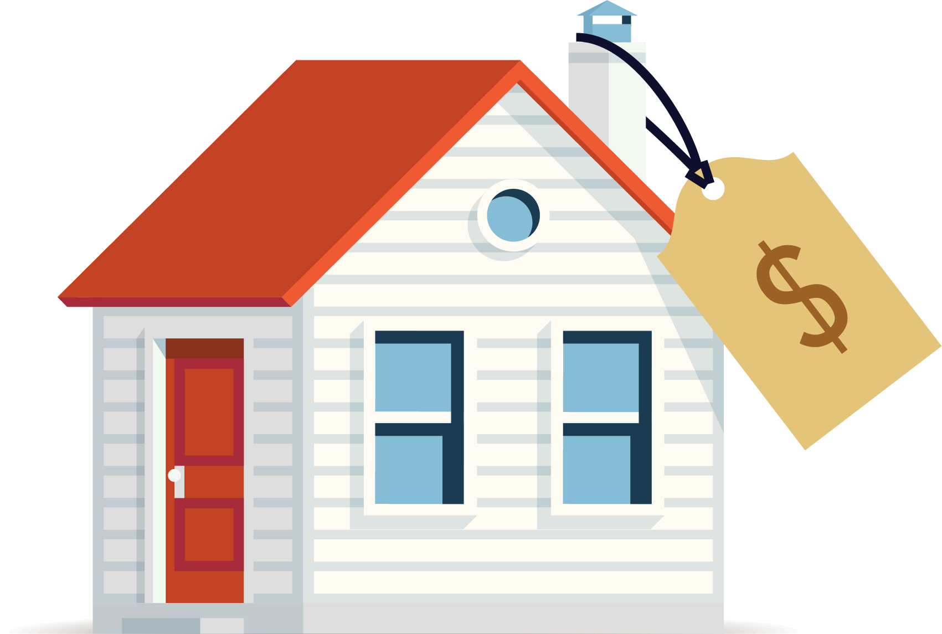
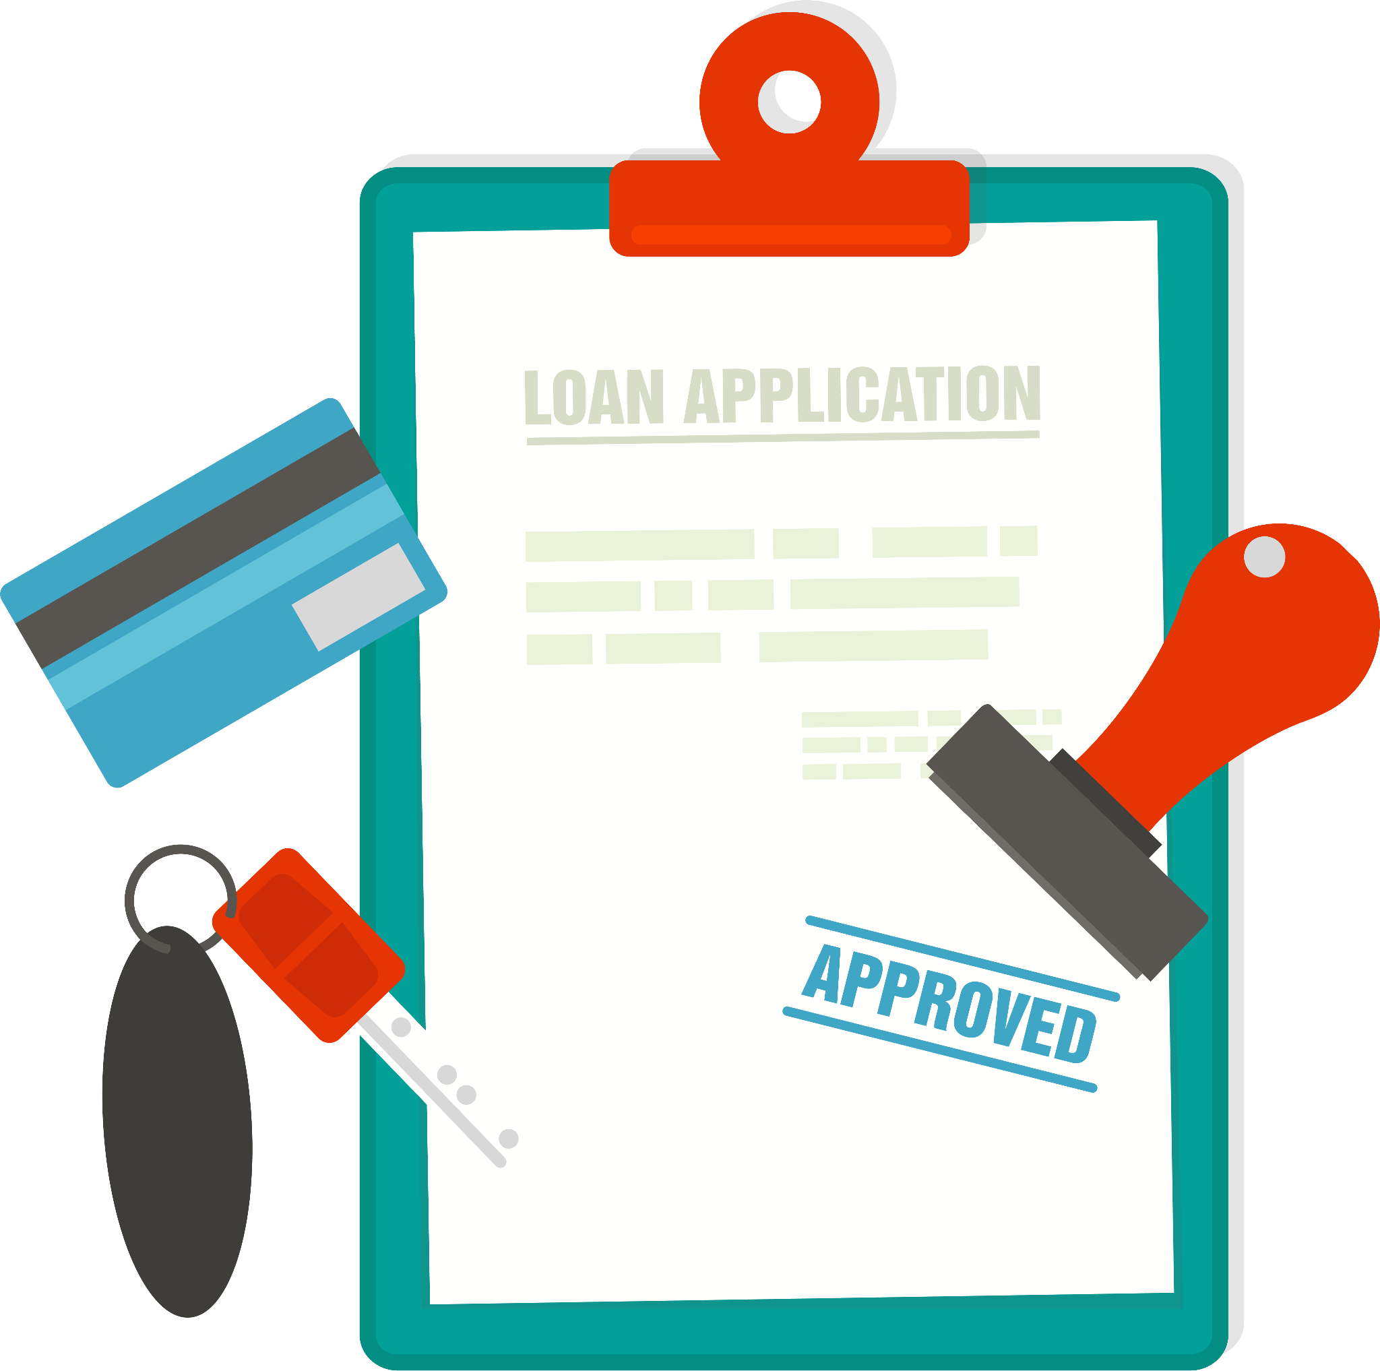
Predicting the price of a house based on its size is an example of a linear problem.
Predicting if a credit application is going to be fraudulent is an example of a non-linear problem.
Notes:
Application; shutterstock_139888051

Slide 28
Decision Trees
Decision trees encode a series of True/False questions.
True/False questions can be represented with a series of if/else statements.
Pet Picker: Do you travel?
if (travel):
if (time > week):
print("Rock")
else:
print("Fish")
else:
if (dress_up):
print("Dog")
else:
print("Cat")
YES
NO
Are you gone more than one week per month?
Do you like to dress up your pets?
YES
NO
YES
NO

Slide 29
Decision Trees: Key Terms
Root Node | A node that is divided into two or more homogeneous sets and represents the entire population or sample data.
Parent Node | A node that is divided into sub-nodes.
Child Node | Sub-nodes of a parent node.
Decision Node | A sub-node that is split into further sub-nodes.
Leaf or Terminal Node | Nodes that do not split.
Branch or Sub-Tree | A subsection of the entire tree.
Splitting | The process of dividing a node into two or more sub-nodes.
Pruning | The process of removing sub-nodes of a decision node.
Trees Depth | The number of decision nodes that the algorithm encounters before it makes a decision.

Slide 30
Root Node
Representing the entire population or sample data, this node gets divided into two or more homogeneous sets.
Root Node
Note: A is a parent node of B and C
Splitting
Branch/Sub-Tree
Decision Node
A
Decision Node
Terminal Node
Decision Node
Terminal Node
Terminal Node
B
C
Terminal Node
Terminal Node

Slide 31
Parent Node
A node that is divided into sub-nodes.
Root Node
Note: A is a parent node of B and C
Splitting
Branch/Sub-Tree
Decision Node
A
Decision Node
Terminal Node
Decision Node
Terminal Node
Terminal Node
B
C
Terminal Node
Terminal Node

Slide 32
Child Node
Sub-nodes of a parent node.
Root Node
Note: A is a parent node of B and C
Splitting
Branch/Sub-Tree
Decision Node
A
Decision Node
Terminal Node
Decision Node
Terminal Node
Terminal Node
B
C
Terminal Node
Terminal Node

Slide 33
Decision Node
A sub-node that is split into further sub-nodes.
Root Node
Note: A is a parent node of B and C
Splitting
Branch/Sub-Tree
Decision Node
A
Decision Node
Terminal Node
Decision Node
Terminal Node
Terminal Node
B
C
Terminal Node
Terminal Node

Slide 34
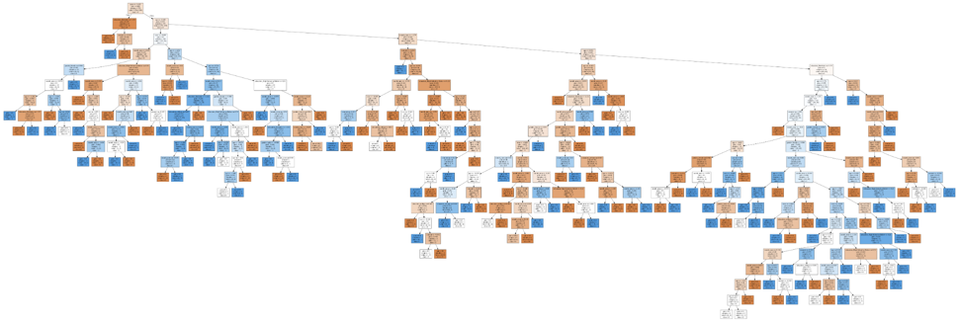
Decision Trees
Decision trees can become very complex and deep, depending on how many questions have to be answered. Deep and complex trees tend to overfit to the training data and do not generalize well to new data.

Slide 35
Decision Trees
Notes:
5. Instructor Do: Decision Trees (15 min)

Slide 37
Activity: Predicting Fraudulent Loan Applications
In this activity, you will will create a decision tree model to predict fraudulent loan applications.
10 minutes
Notes:
6. Students Do: Predicting Fraudulent Loan Applications (10 min)

Slide 38
Notes:
4. Inst7. Instructor Do: Review Predicting Fraudulent Loan Applications (10 min)
Instructor Do: Review Support Vector Machines (15 min)

Slide 40
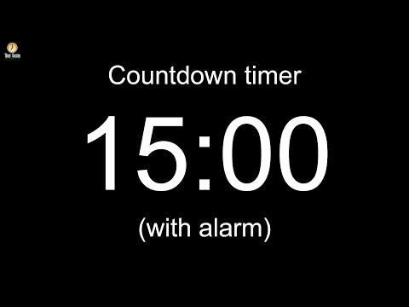
Notes:
8. BREAK (15 min)

Slide 41
Introduction to Ensemble Learning
Notes:
9. Instructor Do: Introduction to Ensemble Learning (10 min)

Slide 42
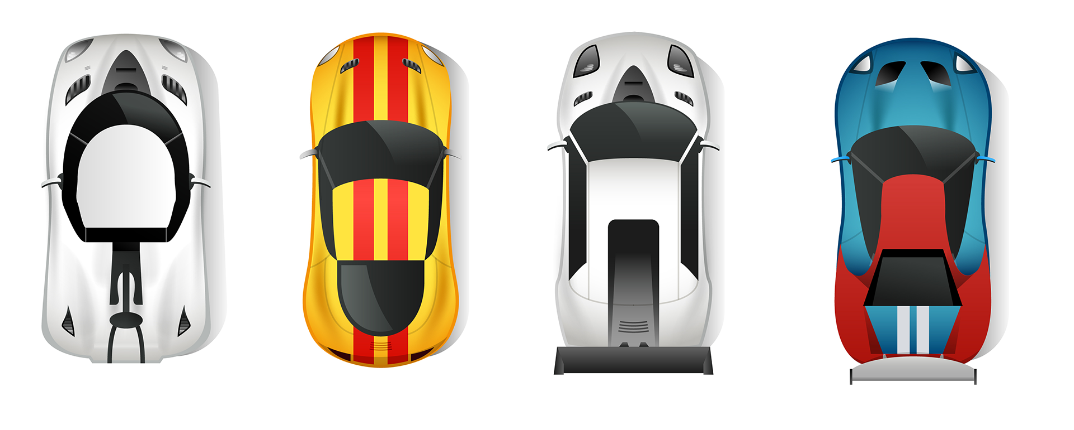
The Classification Algorithm Race
If we compare the performance of classification algorithms, we’ll find that some algorithms perform better than others
Notes:
shutterstock_421232536

Slide 43

You will encounter algorithms that actually fail at learning adequately.
These algorithms/classifiers are considered weak learners.
Notes:
shutterstock_144883519

Slide 44

Weak Learners
Weak learners are a consequence of limited data to learn from.
This may mean there are too few features, or that the data provided does not allow for data points to be classified.
Weak learners make predictions that are only a little better than random chance.
Individually, their predictions of the relationship between inputs and targets are not very accurate.
Despite their flaws, weak learners are still valuable in machine learning.

Slide 45
Can you guess how to make a weak learner perform more accurately?

Slide 46
We can boost weak learners with other algorithms for an ensemble learning approach.

Slide 47
A decision tree can sometimes be classified as a weak learner. Why?

Slide 48
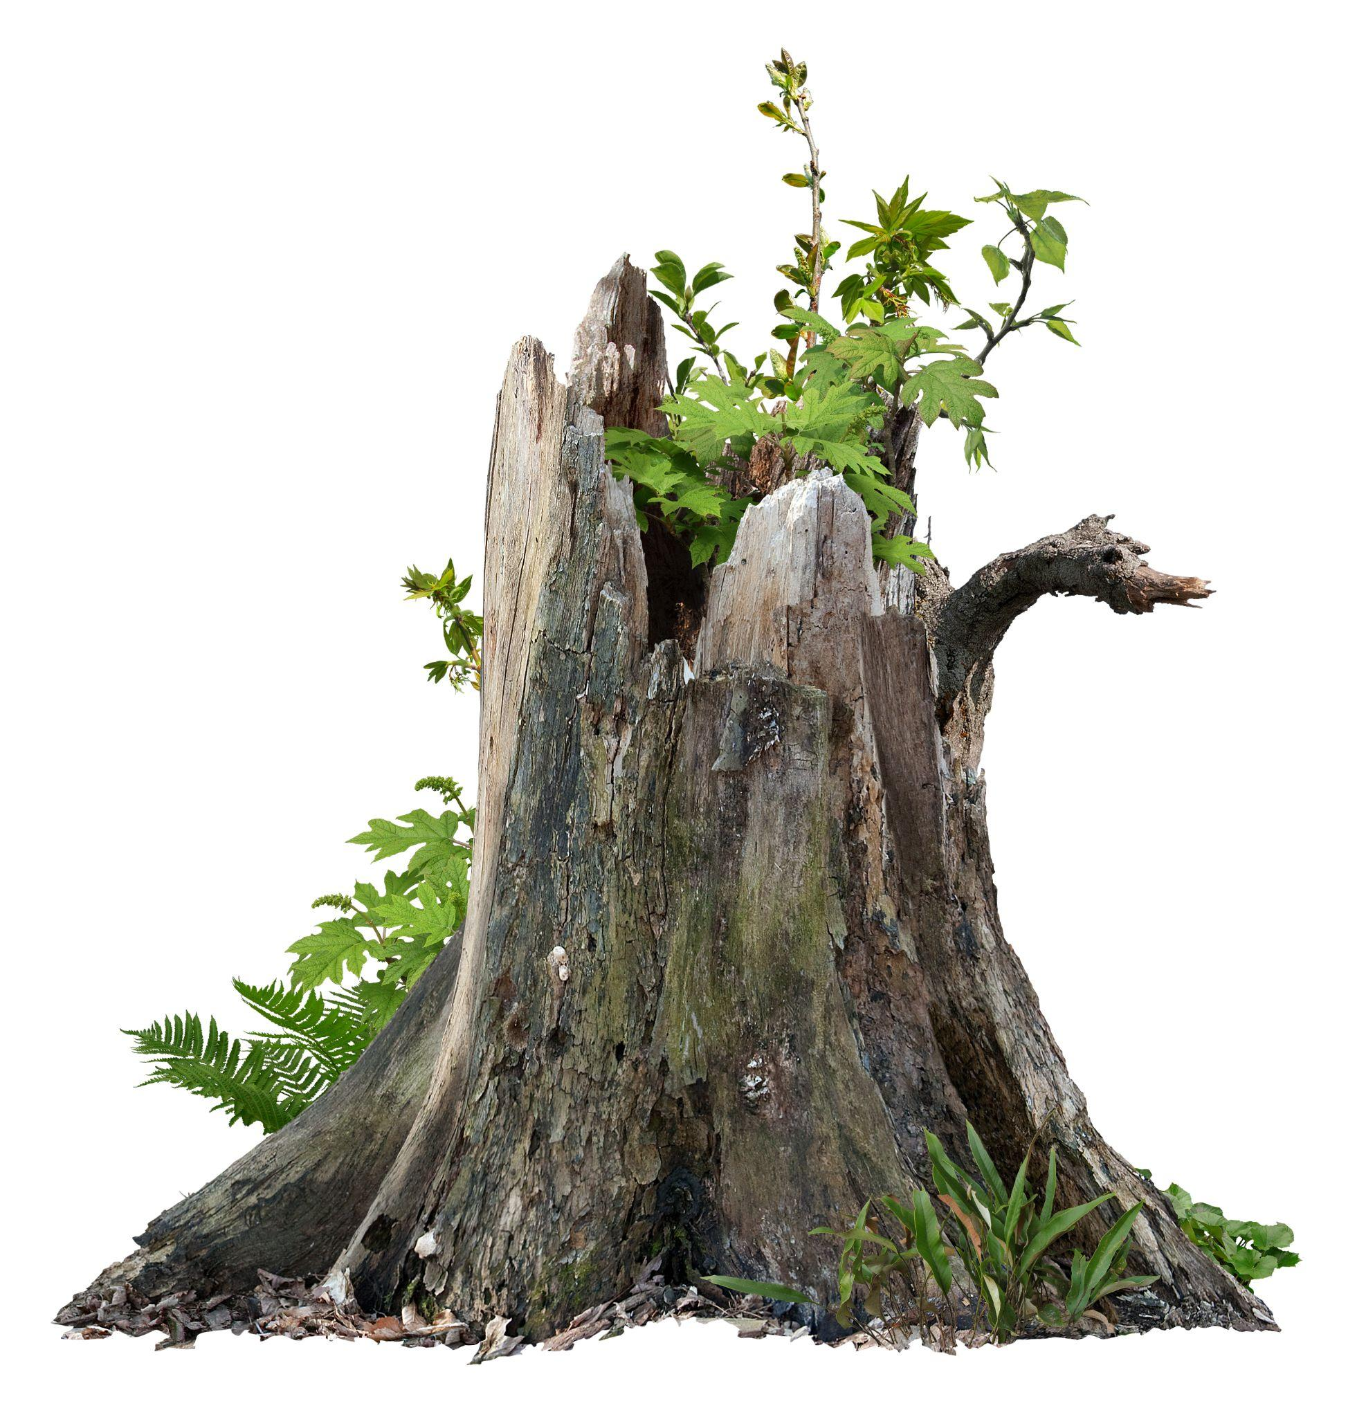
This can happen when a decision tree has only one branch (i.e., a stump).
Notes:
shutterstock_1346346425

Slide 49
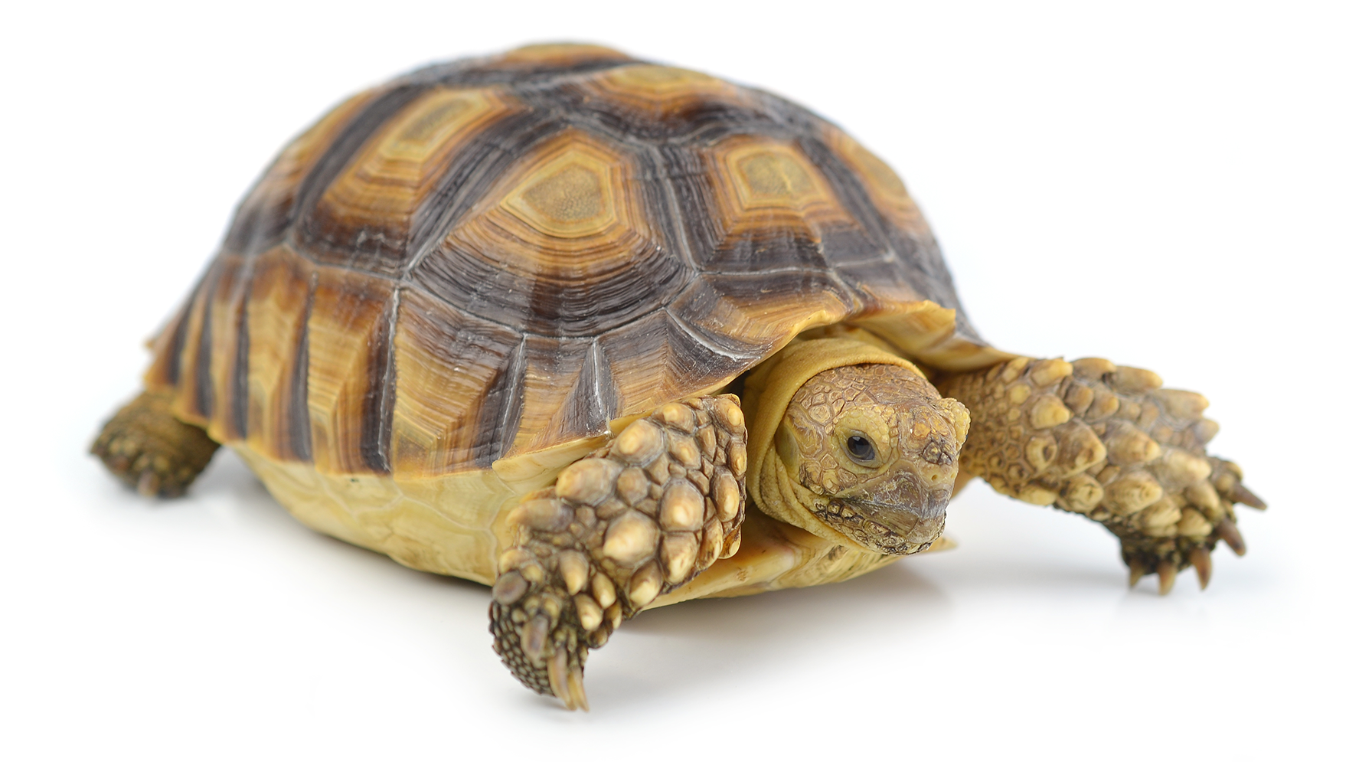
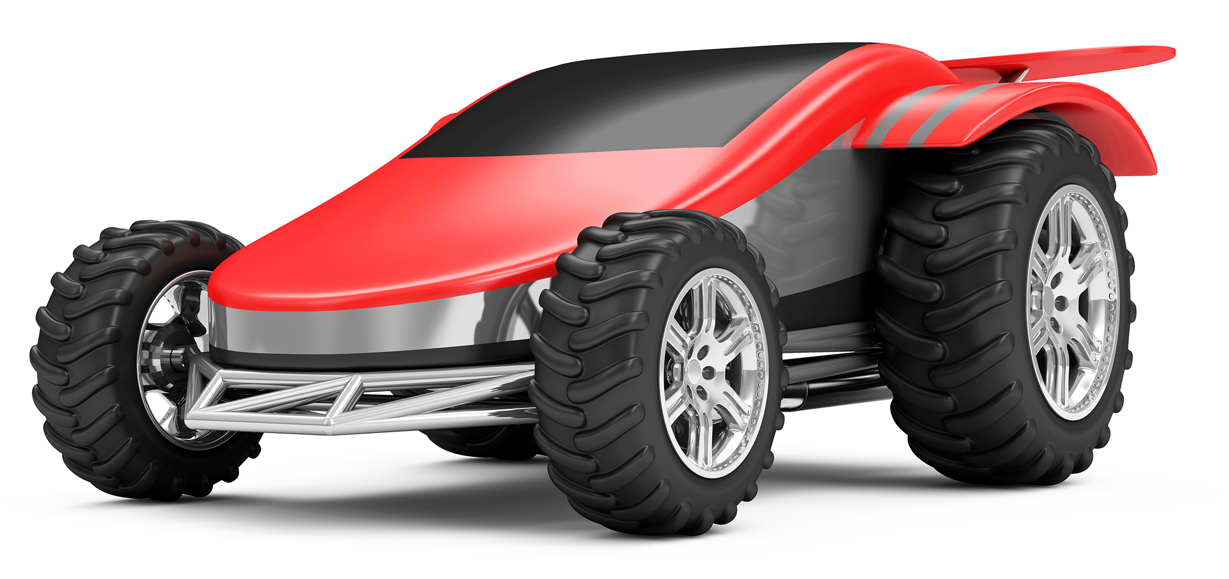
Weak Learners Are Still Valuable in Machine Learning
They can be combined with other classifiers to make a more accurate and robust prediction engine.
Combined weak learners are an example of ensemble learning:
+
Notes:
shutterstock_273346664

Slide 50

Ensemble Learners
Working together, ensemble learners improve accuracy and robustness and decrease variance.
Combined, weak learners can perform as well as strong learners.
Notes:
shutterstock_164493995

Slide 51
Introduction to Ensemble Learning
We have to combine weak learners by using a specific algorithm, such as:
Gradient Boosted Tree
XGBoost
Random forests

Slide 52
Random Forest Algorithm

Slide 53
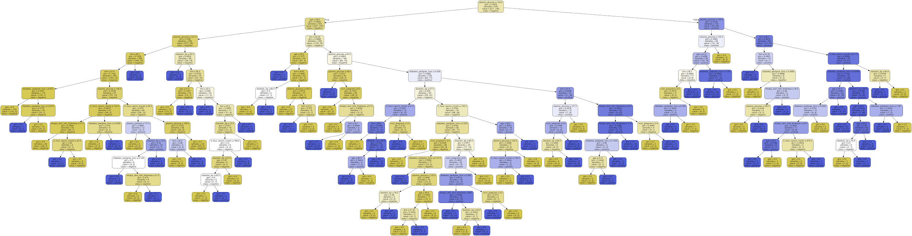
Random Forest Algorithm
Instead of having a single, complex tree, a random forest algorithm will sample the data and build several smaller, simpler decision trees.

Slide 54
Random Forest Algorithm
Each tree is much simpler because it is built from a subset of the data.
Tree 1
Tree 2
Tree 3
True
False
True
False
True
False
True
False
True
False
Input
Tree 1: Green Tree 2: Yellow Tree 3: Green
Output: Green!

Slide 55
Random Forest Algorithm
We create these simple trees by randomly sampling the data and creating a decision tree for only that small portion of data.
Each simple tree is a weak classifier because it is only trained on a small piece of the original data.
By itself, any single tree is only slightly better than a random guess.
However, we can combine many slightly better than average small decision trees to create a strong classifier that has much better decision-making power.
Let's examine some of the benefits of the random forest algorithm.

Slide 56

Random Forest Algorithm: Benefits
Robust against overfitting because each weak classifier is trained on different pieces of the data.
Robust to outliers and non-linear data.
Runs efficiently on large databases.

Slide 58
Random Forest
Notes:
10. Instructor Do: Random Forest (10 minutes)
10. Instructor Do: Random Forest (10 minutes)

Slide 60
Activity: Predicting Fraud with Random Forests
In this activity, you will explore how to use the random forest algorithm for identifying fraudulent loan applications.
15 minutes
Notes:
10. Students Do: Predicting Fraud with Random Forests (15 minutes)

Slide 61
Notes:
11. Instructor Do: Review Predicting Fraud with Random Forests (10 minutes)

Slide 63
K-Nearest Neighbors
Notes:
12. Instructor Do: K-Nearest Neighbors (10 minutes)

Slide 64
K-Nearest Neighbors
Earlier, we learned that the k-nearest neighbors algorithm is useful for unsupervised learning because it groups the dataset into different categories.
We also can use k-nearest neighbors for supervised learning (data with labeled outcomes).
k-nearest neighbors can categorize observations and choose class labels for data that are most similar to each other.
We can choose to classify an unknown point by averaging the known label values around it.
Closer points are weighted so that they contribute more to the average than distant points.
Training instance
Class 1
Class 2
Distance
K = 3
K = 1
?
New example to classify

Slide 66
Activity: K-Nearest Neighbors
In this activity, you will use data on a bank’s telemarketing campaign to build a model to classify customers.
15 minutes
Notes:
13. Students Do: K Nearest Neighbors (20 minutes)

Slide 67
Notes:
14. Instructor Do: Review K-Nearest Neighbors (10 minutes)

